Slide 1
Second order methods for training
Optimization algorithms that use only the gradient, such as gradient descent, are called first-order optimization algorithms. Optimization algorithms that also use the Hessian matrix, such as Newton’s method, are called second-order optimization algorithms (Nocedal and Wright, 2006).
In contrast to first-order methods, second-order methods make use of second derivatives to improve optimization. The most widely used second-order method is Newton’s method

Slide 2
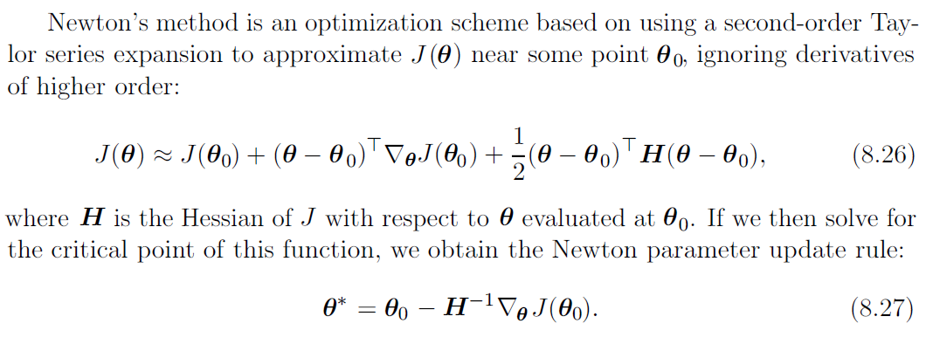
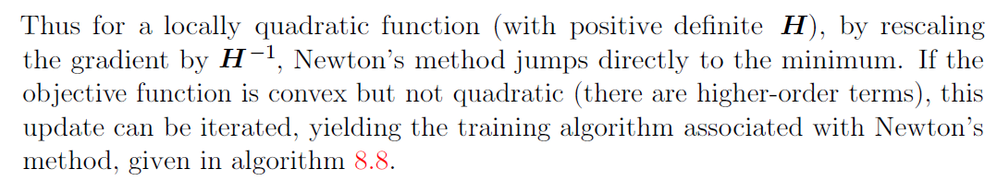

Slide 3
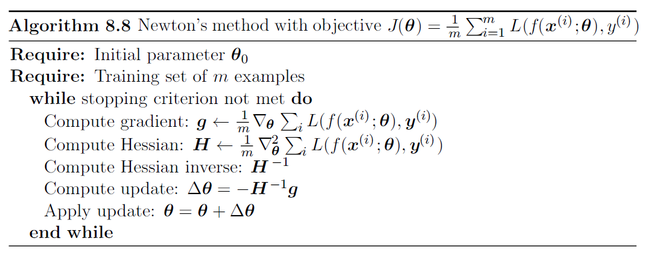

Slide 4
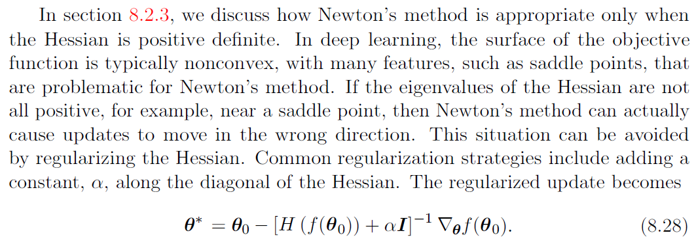

Slide 5
Computing and inverting the Hessian of a neural network loss can be costly (order of parameters squared or cubed)
Quasi Newton methods:
Broyden–Fletcher–Goldfarb–Shanno (BFGS) algorithm (Computes inverse Hessian approximation Mt)
Limited Memory BFGS (or L-BFGS) (Computes inverse Hessian approximation Mt with Mt-1 as identity matrix)

